Slide 1
Welcome To Microprocessors and Embedded Systems [L] Group-08, Final Presentation
Submitted to
“DR. MUHIBUL HAQUE BHUYAN”
Group members
Name | ID
MD ASHRAFUL AMIN SAKIB | 20-42940-1
ABDULLAH AL MAHADI | 20-42044-1
PARTHA ROY | 20-43575-1
PARTHA MALAKAR | 20-42908-1
SUBRATA DAS | 19-40015-1

Slide 2
“Arduino based Automated Irrigation system Monitoring ”
OUR PRESENTION TOPIC

Slide 3


States of this presentation
Introduction
Abstract
Literature Review
Basic Idea of The Project
Software Implementation For Smart Irrigation System
Results and Discussion
Future Work
Challenges and Limitation
Conclusion

Slide 4

Introduction :
Irrigation is the process by which we supply water to land or crops to help better growth of different types of crops. In our country our farmers are actually using the traditional method for watering the crops and monitoring the growth. We are come here with a smart solution for our farmers-called smart irrigation.
As an Engineer our responsibility is to provide better solution for our society. From this point of view we are going to develop a Smart irrigation system solution by using Ultrasonic sensor, Soil Moisture Sensor, Arduino Uno, 2N2222 BIPOLAR Silicon NPN Low Power High Frequency Bipolar Transistor (500mW, 200ºC), Relay Active animate relay model, Capacitor, Inductor and other necessary components.

Slide 5
Abstract
Nowadays, Science and Innovation make our life faster and easier. Bangladesh is an agricultural Country but from the very beginning our farmers are using the traditional method in their farming. But it’s high time to introduce technology in this sector. From this point of view we are going to provide a smart solution. The goal of the project is to design an automatic irrigation system monitoring for the farmers. In This Plant Watering System, Soil Moisture Sensor checks the moisture level in the soil and if moisture level is low then Arduino switches on a water pump to provide water to the plant. Water pump gets automatically off when system finds enough moisture in the soil. This system will be very sustainable and useful in Farms, gardens, home etc. This system will be completely automated and there is no need for any human intervention.

Slide 6
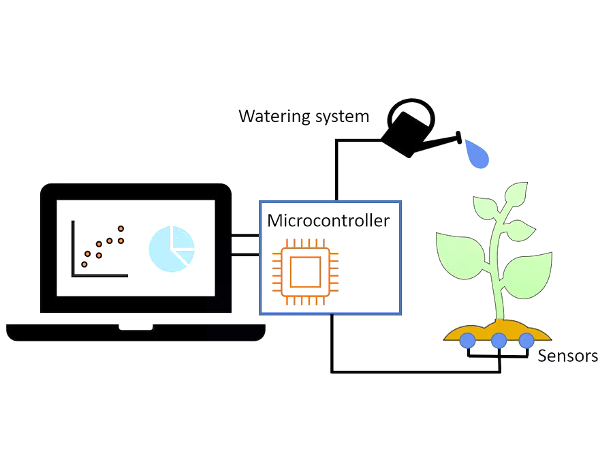
Literature Review: :
Najaf – IRAQ (4th SICN-2019-4th Scientific International Conference) invent or provide a solution for smart irrigation system using Arduino and GSM based message notification with monitoring system for farmers. He give a better solution but there are some limitation as well of this project-first of all this project is not reasonable at all and secondly need apps and android phone but as we are thinking this project for our poor or local farmers so using android apps or high configuration mobile can cause problem for our local farmers. But for city area or city farmers might be create a great impact [1]. Mrs Roopa Mahadev, Kushmithaa N, Meghana H, Mukrram Pasha and Niveditha S invent a smart irrigation solution on May 2018 ISSN (online): 2349-6010. This project is also good but some limitation like solar power energy, or more function they can easily add in their work. Here they are using the message alert system which is very innovative and impactful for our rural and city farmers as well. But here we are going to provide an easy and cost friendly solution for our rural farmers. [2]

Slide 7
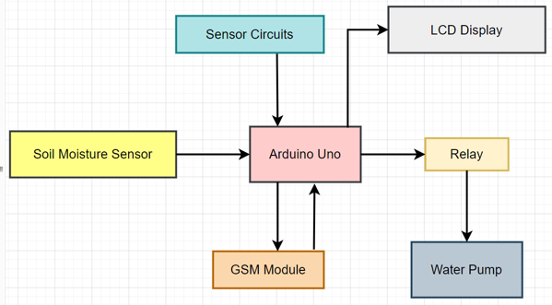
Basic Idea of The Project

Slide 8
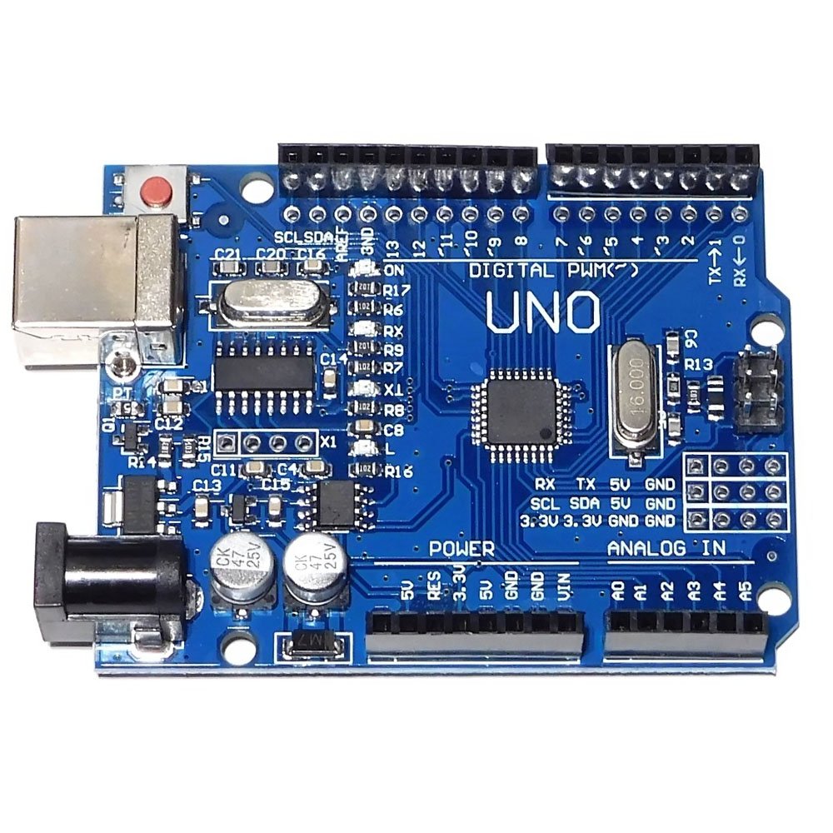
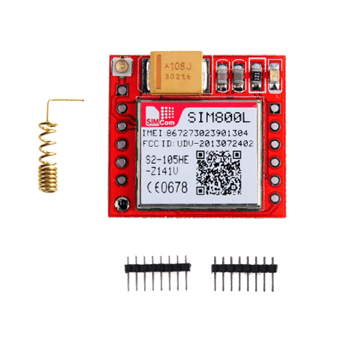
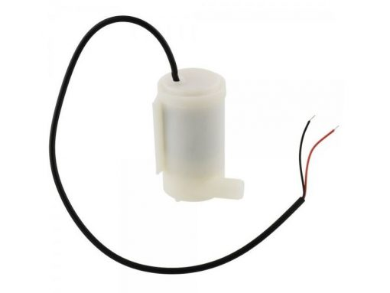
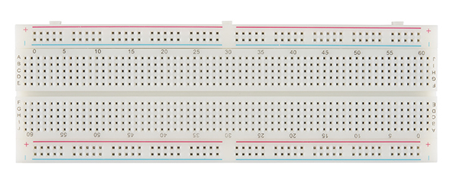
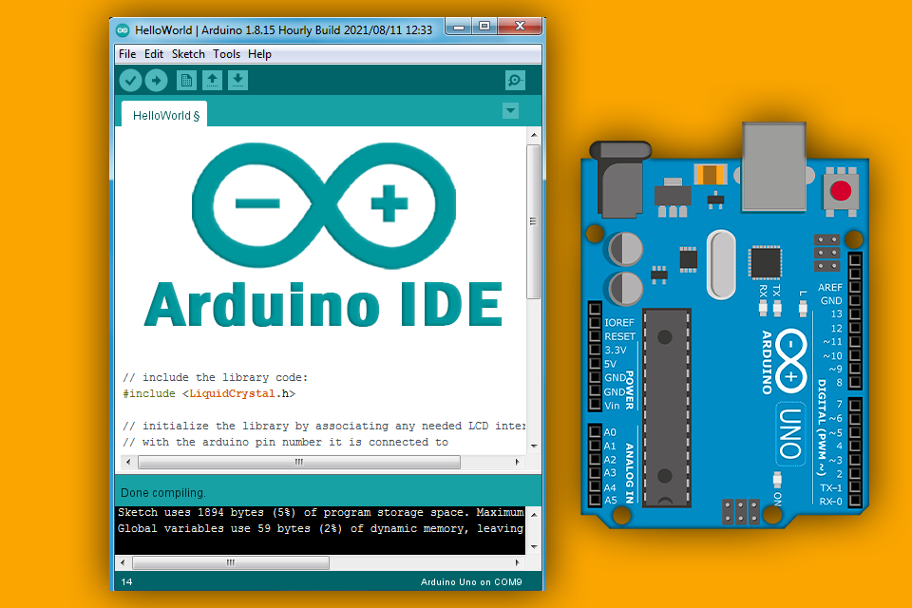
Software Implementation For Smart Irrigation System In the simulation part we use proteus 8 professional software and Arduino for code generation and running. First of all we take all the component as necessary and then implement the circuit as follow in the figure. After implementing the circuit we write down the code in the Arduino and compiled i. After compiled successfully then we put it on the proteus. In the mean time we locate the Hex file in our c drive and copy the link and put the file link in the Arduino board. Secondly in the similar process from the library we add soil moisture sensor hex file and run the simulation successfully. Thus our condition and logic behind of the project is working successfully.

Slide 9
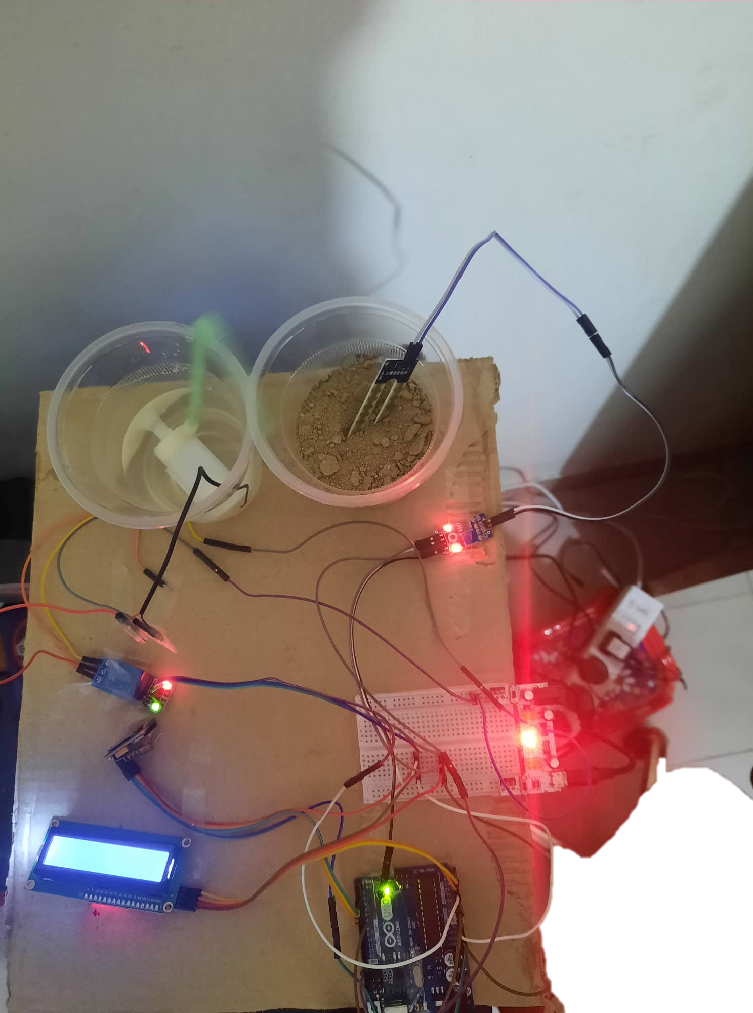

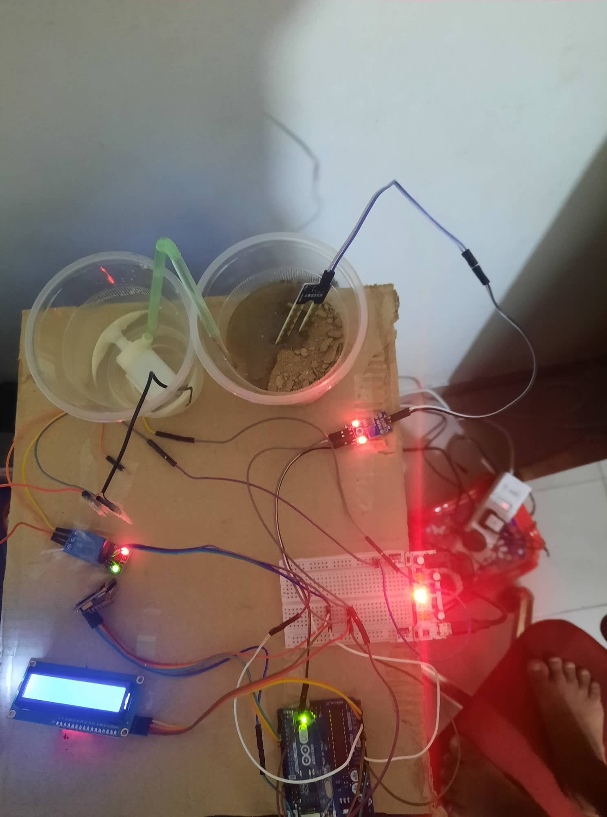
Results and Discussion
we can see that the simulation logic and condition matched properly. It will going to be a great solution with a cheap cost for our farmers. There is no error in the simulation but also have some limitation of time , fund regarding software or research opportunities. So we can easily say that the objective or goal of the simulation work is proved.

Slide 10
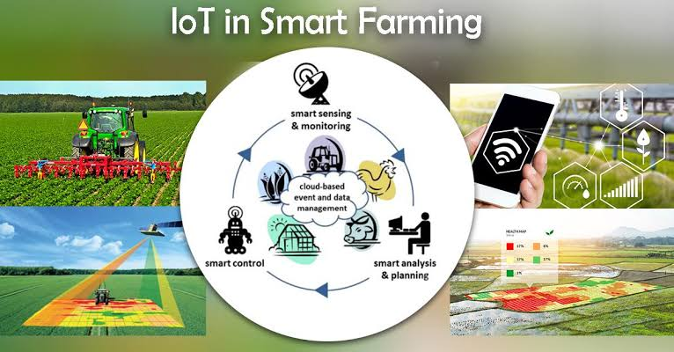
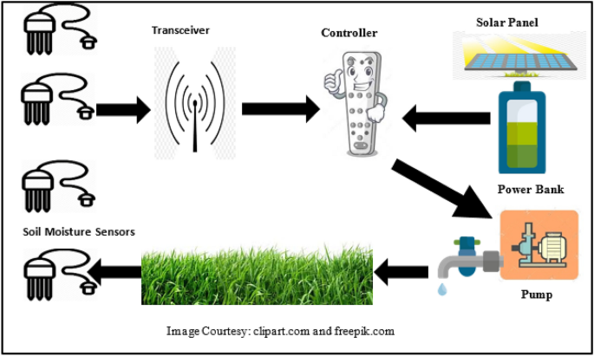
Future Work
Purpose of the project.
Outcome of the project.
Methods to improve.
Testing new modules for improvement.
Platform independent workflow making.
Energy generation and consumption.
Adding functionalities.

Slide 11
Challenges and Limitation
Every work has a limitation in the world. So our work in not special from this point of view. First of all we want to add GSM module but for some short hand we could not use this properly so we remove this option. If our Arduino module is damaged then the system will not going to run properly. The whole system will turn off so that’s the main limitation we find till now. Otherwise all the process, code and simulation step was done perfectly as per our goal to provide a smart solution for poor rural farmers.

Slide 12
Conclusion
In conclusion we can say that the project has a high social impact. As it is already dealt, the system is none existing, and still majority of the farmers use the traditional human intervention based irrigation, due to which there is huge loss in cultivation. Benefits and can be operated with less manpower.
Over-watering and under-watering affects the crop so proper amount of water should be supplied. By analyzing the soil parameters system waters the farm. So by this wastage of water reduced. It reduces the human resources. This irrigation system was found to be feasible and cost effective for optimizing water resources for agricultural production. The irrigation system can be adjusted to a variety of specific crop needs and requires minimum maintenance.

Slide 13
References:
K. Sirohi, A. Tanwar, Himanshu, and P. Jindal, “Automated irrigation and fire alert system based on hargreaves equation using weather forecast and ZigBee protocol,” in 2016 2nd International Conference on Communication Control and Intelligent Systems (CCIS), 2016, pp. 13–17.
G. Shruthi, B. S. Kumari, R. P. Rani, and R. Preyadharan, “A-real time smart sprinkler irrigation control system,” in 2017 IEEE International Conference on Electrical, Instrumentation and Communication Engineering (ICEICE), 2017, pp. 1–5.
S. R. M. Zeebaree and H. M. Yasin, “Arduino Based Remote Controlling for Home: Power Saving, Security and Protection,” Int. J. Sci. Eng. Res., vol. 5, no. 8, pp. 266–272, 2014.
S. M. A. Kumar, “AUTOMATED IRRIGATION SYSTEM BASED ON SOIL MOISTURE USING ARDUINO,” Int. J. Pure Appl. Math., vol. 116, no. 21, pp. 319–323, 2017.

Slide 14

Thank You!

